Slide 1
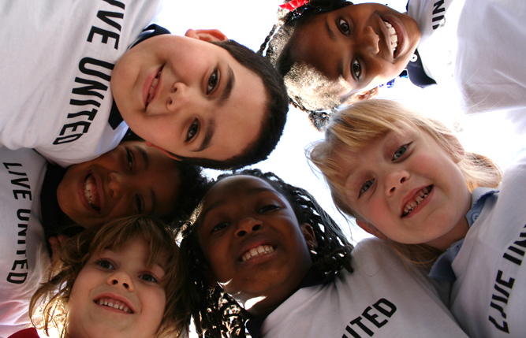
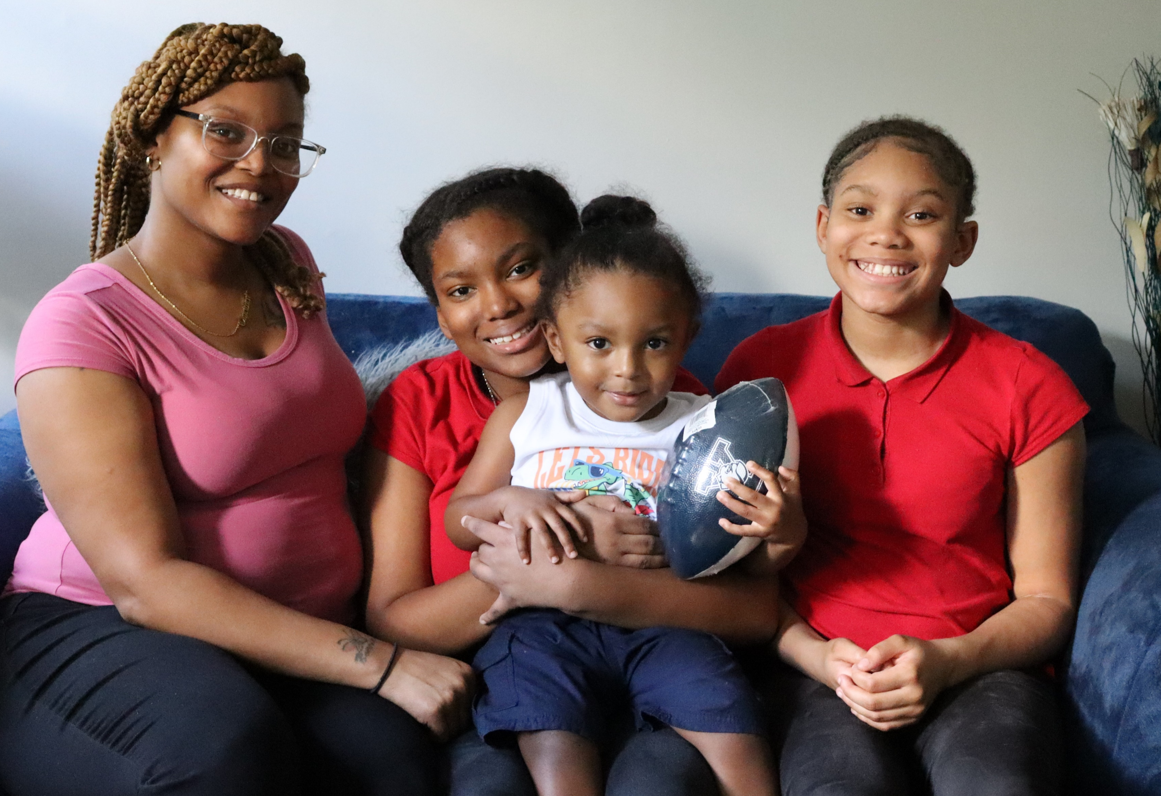

Slide 2
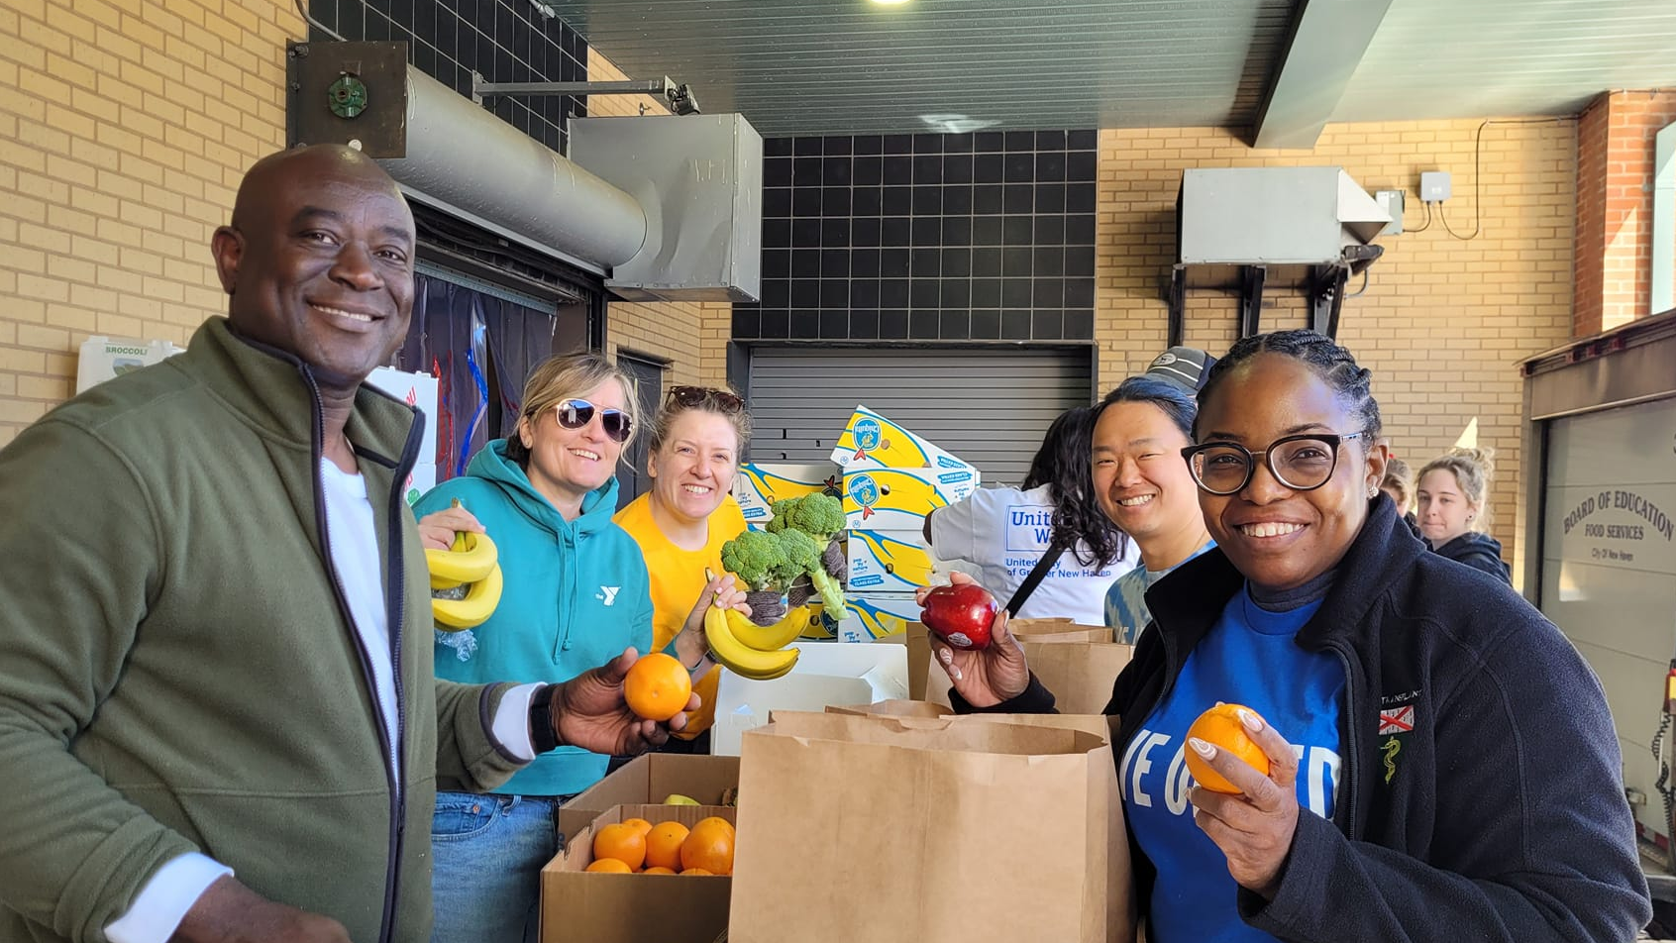

Slide 3
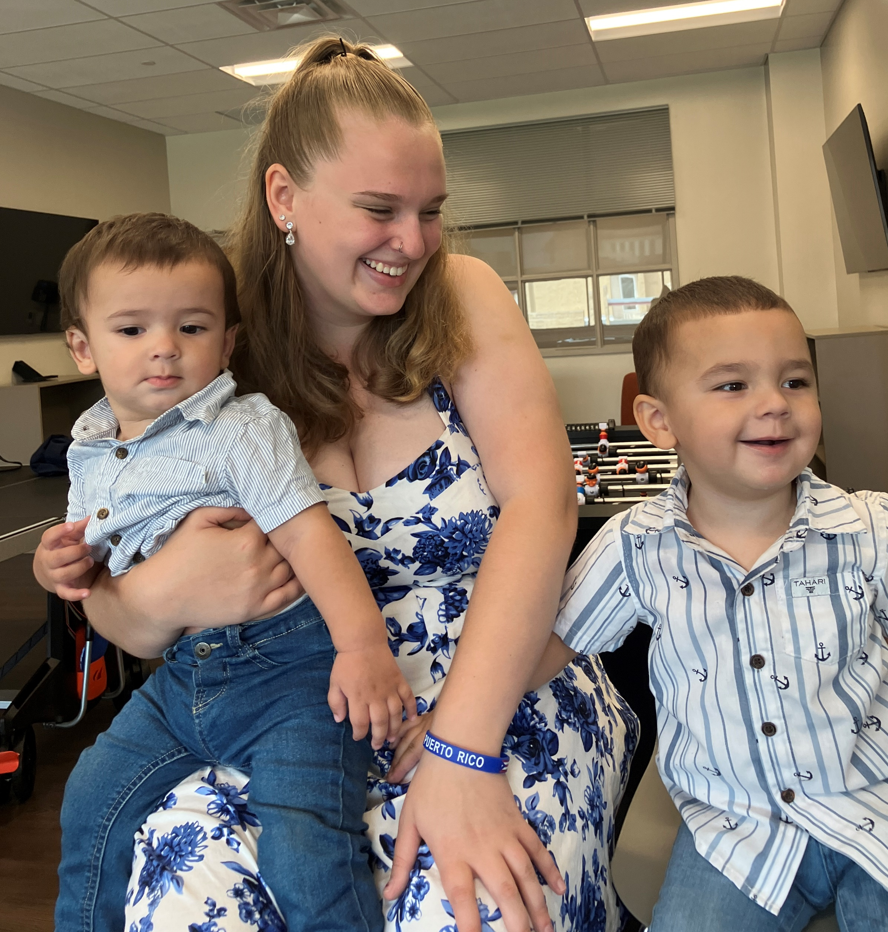
Everyone deserves to be part of a thriving community.
That’s why United Way brings neighbors, businesses, and community partners together to increase access to food and stable housing, advance the well-being of children, promote economic mobility, and work towards a better future for all.
Join us and help lead the way.

Slide 4
Every neighbor deserves nutritious food and stable affordable housing.
Rising costs of food, rent, and child care mean more families in our community are struggling to afford the basics.
We help families find and keep safe housing and access healthy food through pop-up pantries, summer meals for kids, serving prepared meals, and more.

Slide 5
Every child can learn, grow, and thrive with quality child care and education.
Every child needs stability, resources, and a network of healthy relationships.
We support parents and caregivers, promote healthy development, expand access to summer enrichment programs, get books and school supplies to students, and support literacy and math skills.

Slide 6
Every family can build a better life when they have a strong financial foundation.
42% of households in Greater New Haven don’t make enough money to afford basic necessities.
We help people develop career skills, offer free tax preparation, and provide financial education so people can make, keep, and grow the resources to achieve their goals.

Slide 8
United Way donors are leading the way – improving access to education, food, stable housing, and financial stability so that all can thrive.

